Slide 1
Title IX Training
K-6
“Student safety is my number one priority. I take very seriously and very personally any incident that may negatively impact our communities’ kids and families.”
-Dr. Bishop, Superintendent
Notes:
(Read slide)

Slide 2

Law
Notes:
Today we are going to talk about an important law called Title IX.
Title IX is the law that requires girls and boys to be treated fairly.

Slide 3
What is a law?
A law is a rule that is set by lawmakers in Washington D.C., which is the capital of the United States.
Notes:
What is a law? Basically it is a rule that tells you what is right and what is wrong and what is allowed or not allowed.
The adults in your home set the rules there. Your teachers and school principal set the rules of your school.
A law is a rule set by people called “lawmakers,” who are elected by adults who vote.
The Title IX rule was set by lawmakers in Washington D.C., which is the capital of the United States.
The Title IX rule applies to everyone, no matter if you live in Alaska or in some other state.

Slide 4
ASD Rules
ASD Board Policy 5145.7
The Board shall not tolerate the sexual harassment of any student by any other student or any district employee. Any student or employee who is found guilty of sexual harassment shall be subject to disciplinary action.
ASD Administrative Regulation 5145.7
It is the intent of the Anchorage School District to provide an environment for students that is free from sexual harassment and sex-based discrimination whether based on sex, gender identity, sexual orientation, gender nonconformity, transgender status, or any other unlawful consideration.
Notes:
The Superintendent of the Anchorage School District is responsible for all the schools in the school district.
The Superintendent knows that for you to have a positive experience at school, you must feel safe. Title IX requirements ultimately support the goal to provide you a learning environment in which you feel safe while in school.
“The Anchorage School Board and Administration are committed to providing an open learning environment where students and employees feel safe, cared for, and that they belong.”
-Dr. Bishop Superintendent

Slide 5
Safety
Title IX law is about helping you to feel safe in school.
Notes:
The Superintendent of the Anchorage School District is the boss of all the schools in the school district.
The Superintendent knows that for you to have a good experience at school, you must feel safe. The Title IX law is about helping you to feel safe in school.
“The Anchorage School Board and Administration are committed to providing an open learning environment where students and employees feel safe, cared for, and that they belong.”
-Dr. Bishop Superintendent

Slide 6

Discrimination
Notes:
Sometimes other students are mean to you because of the way you are. This is called discrimination.
Discrimination is when someone is mean to you because you are a boy or a girl, or because of where you are from, or maybe even because of the color of your skin.
Title IX law is meant to protect you from people being mean to you because of the way you are.

Slide 7

Gender Discrimination
Notes:
Title IX law is especially important when someone is mean to you because you are a boy or a girl, or because they think you don’t act the way a girl or a boy is supposed to act.
The law says that it is wrong for someone to treat you unfairly because you are a girl or because you are a boy.

Slide 8
Bullying
Verbal
Written
Physical
Notes:
Title IX also protects you from bullying, which is when someone is mean to you at school.
There are three kinds of bullying: verbal, physical, and written.

Slide 9

Verbal Bullying
When someone says something mean.
Notes:
Sometimes someone in your class says something mean to you or makes fun of you. This is verbal bullying.
Title IX law is meant to keep you safe from someone saying mean things to you because you are a girl or because you are a boy.
It is also meant to keep you safe when someone makes fun of you because they think you don’t act enough like a girl or like a boy.

Slide 10


Written/Cyberbullying
Written messages that are mean or hurtful can be written on paper, online, or through text messages.
Notes:
Written bullying or cyberbullying is like verbal bullying except the mean or hurtful statements are written down.
These messages can be written down on something like paper, online, or in text messages.
If someone you don’t know is trying to talk to you online, tell an adult.

Slide 11
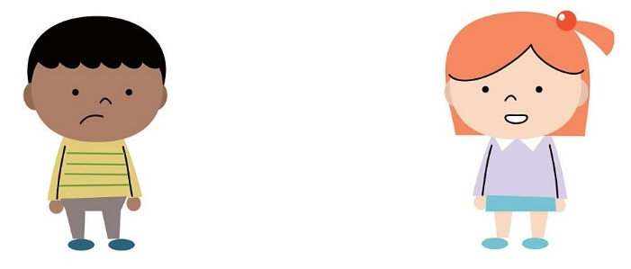
Physical Bullying
Notes:
Physical bullying is when someone touches you when you don’t want them to touch you, or touches you in a way that hurts you.

Slide 12
Touch
Good
Bad
Confusing
Notes:
Your body belongs only to you, and you decide when it is okay for someone to touch you.
There are three types of touching: good touch, bad touch, and confusing touch.
Now lets talk more about each kind of touch.

Slide 13



Good Touch
Notes:
Good touch makes you feel good, comfortable, loved, and safe.
Examples of good touch include hugs, handshakes, and high-fives.

Slide 14
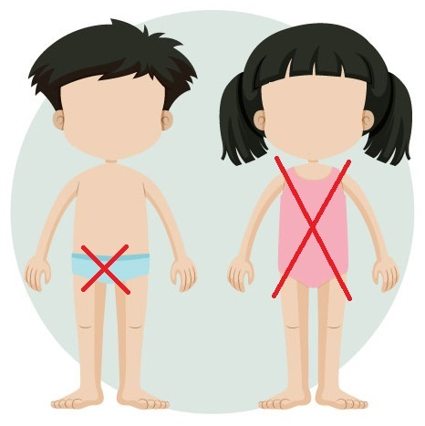
Bad Touch
Notes:
There is another type of touch called a bad touch.
A bad touch makes you feel uncomfortable, bad, or scared.
A bad touch may hurt and may even leave a mark on your body. These kind of touches may be a hit, kick, or when someone touches you on your private parts.
Private parts are the parts of your body that are covered up by a bathing suit. Private means that it is something you do not share. People should not be touching the parts of your body that are covered by a bathing suit.

Slide 15

Confusing Touch
Notes:
The last type of touch we are going to talk about is called a confusing touch.
A confusing touch may start out feeling okay, but then it feels uncomfortable or unsafe.
Some examples of confusing touch may be when someone you don’t know gives you a hug, or when someone tickles you and won’t stop after you’ve asked them to stop.
Also, sometimes doctors or nurses have to touch parts of our bodies when we are hurt or sick and this touching makes us feel uncomfortable. It is confusing because it feels uncomfortable but they are touching us because they are doing their jobs to make sure we are healthy or to help us heal.

Slide 16
Three Rules
Say No
Get Away
Tell Someone
Notes:
There are three things you must remember to do if you ever have a situation that makes you feel uncomfortable, scared, or unsafe.
The three rules are:
Say no.
Get away.
And Tell someone.
When someone is being mean to you or touching you in a way that makes you feel uncomfortable, say “no” or “stop.” Even if the adult is someone you know and trust, you can say “no” or “stop” if it makes you uncomfortable. You can say “no” or “stop” to any kind of touch at any time, even a good touch.

Slide 17
Tell Someone
Teacher
Parent
Counselor
Principal
Custodian
Classroom Aide
Cafeteria Staff
Notes:
We all should know who to tell when we don’t feel safe.
When you feel scared or sad because someone is being mean to you at school you should tell an adult who works in the school as soon as you can. You could tell your teacher, a parent, counselor, principal, custodian, or cafeteria staff.
parent, counselor, principal, custodian, classroom aide, or cafeteria staff. These are just a few examples.
Think about who you might talk to if you feel unsafe or uncomfortable.

Slide 18
Quiz
A student reports to the school principal that she was sexually assaulted at school. The school forwards the report to the police department, and the school does not do its own investigation.
Title IX concern?
Notes:
YES
School districts have an independent obligation to timely investigate a student’s Title IX claim.
The police department may ask the school not to interview students until officers can interview them as possible witnesses in the criminal case. The school can agree to a brief delay, but the school must then promptly complete its own investigation.

Slide 19


Questions?
Notes:
Thank you for being such good listeners.
It is okay if you have questions about Title IX law and what we talked about today.
If you have questions, you can talk to your teacher or another adult at the school.
We will also give you a handout with some tips to help you remember what we talked about today.
The adults in your home may want to call us and ask questions, too.
And remember, say no, get away and tell an adult if you feel scared or unsafe.

Slide 20
Contact Us
ASD Office of Equity & Compliance
Title IX Coordinator
Equity@asdk12.org
(907) 742-4132

